Slide 1
Homochiral ideas
Marianne Imperor-Clerc
April 2026

Slide 2
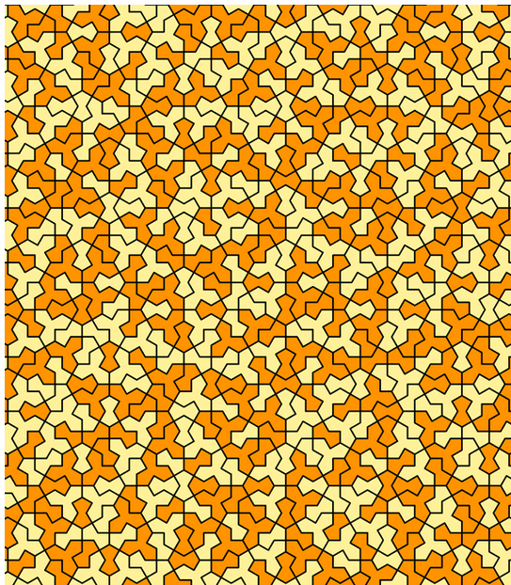
Wheel tiling
https://tilings.math.uni-bielefeld.de/substitution/wheel-tiling/
Nissen, Hans-Ude

Slide 3
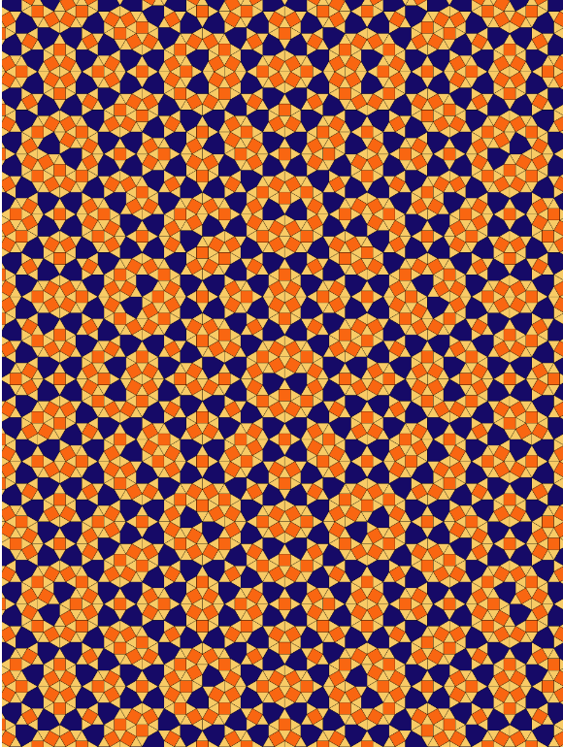
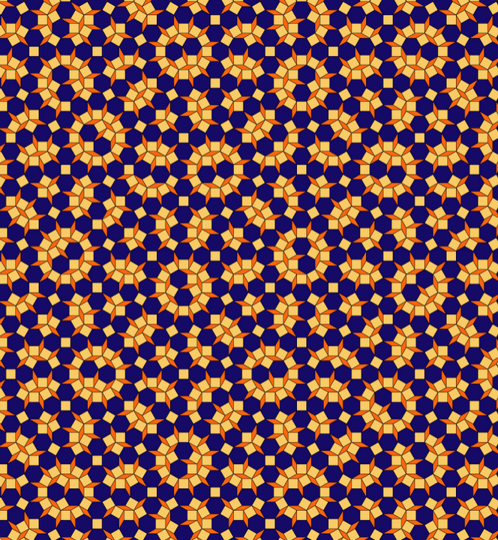
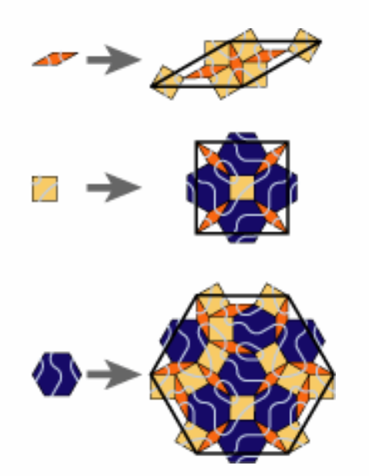
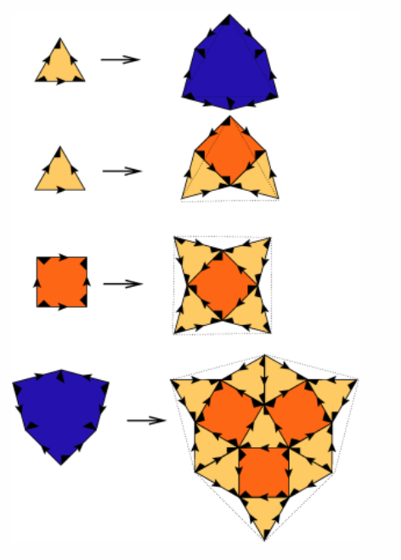
Wheel tiling -> shield and Socolar tilings
There is a very simple rule to transform the wheel tiling into the shield tiling: Replace each edge in the tiling by an edge orthogonal to it, of equal length, such that the old and new edge intersect in their midpoints. Applying this rule to the wheel tiling yields the shield tiling and vice versa.
https://tilings.math.uni-bielefeld.de/substitution/shield/
https://tilings.math.uni-bielefeld.de/substitution/socolar/

Slide 4
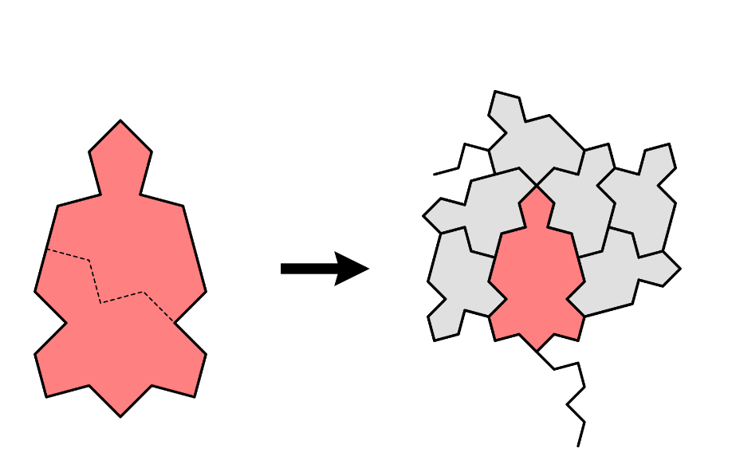
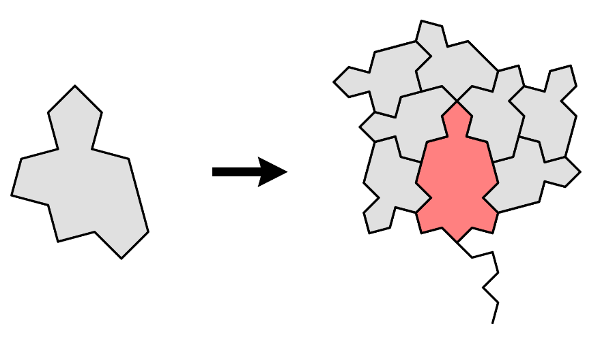
H7/H8 by Simon Tathan
https://www.chiark.greenend.org.uk/~sgtatham/quasiblog/aperiodic-refine/
https://arxiv.org/abs/2512.16595

Slide 5
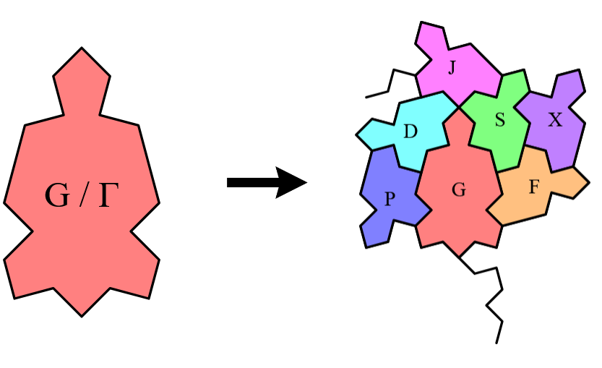
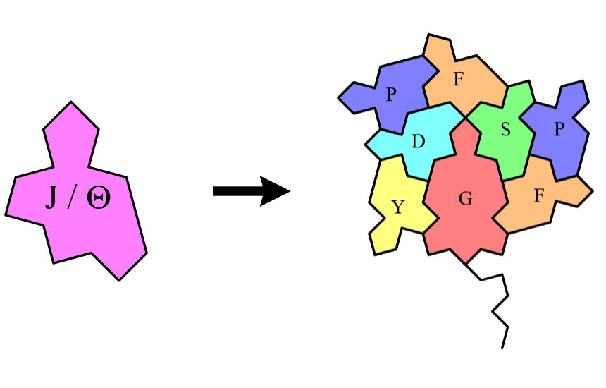
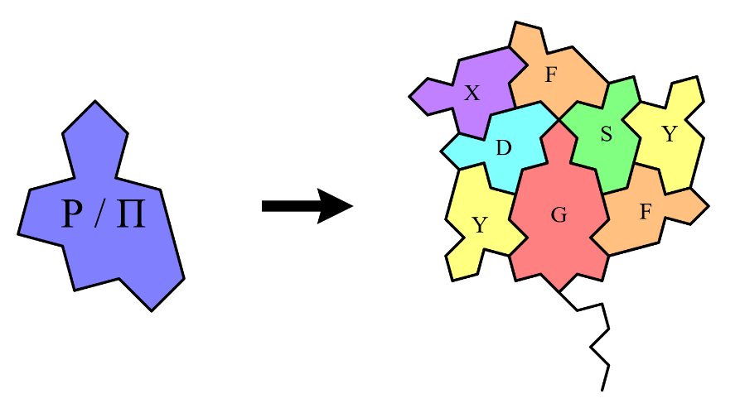
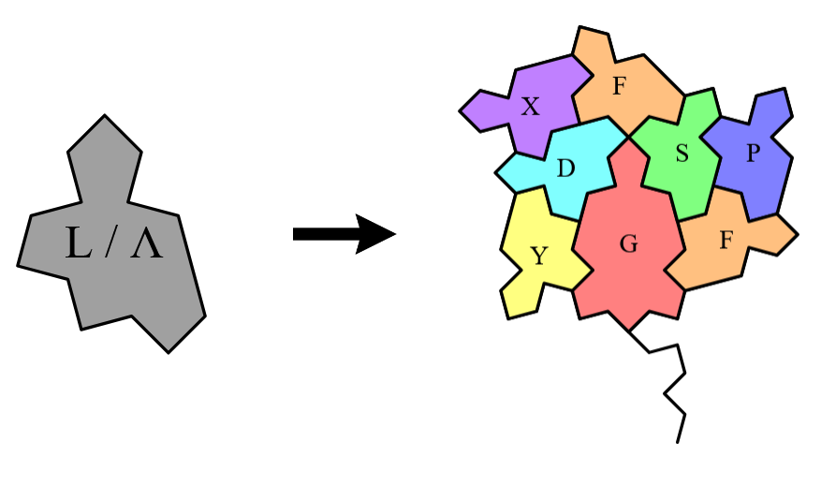
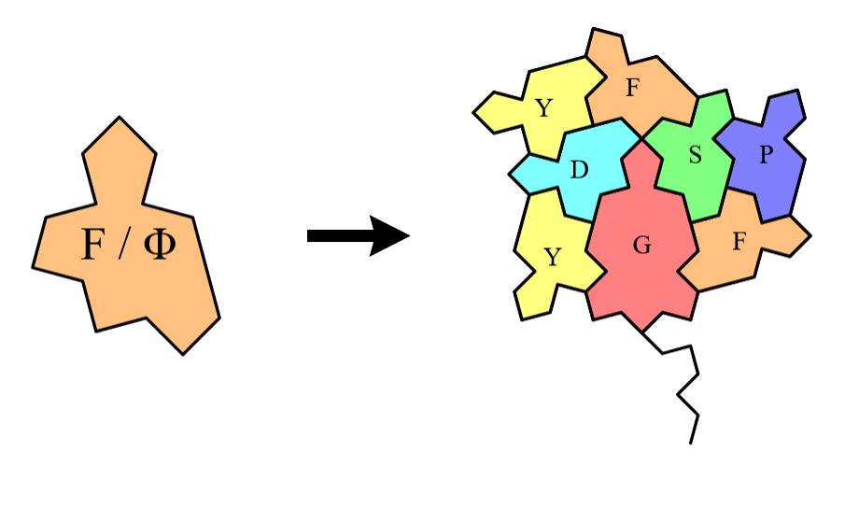
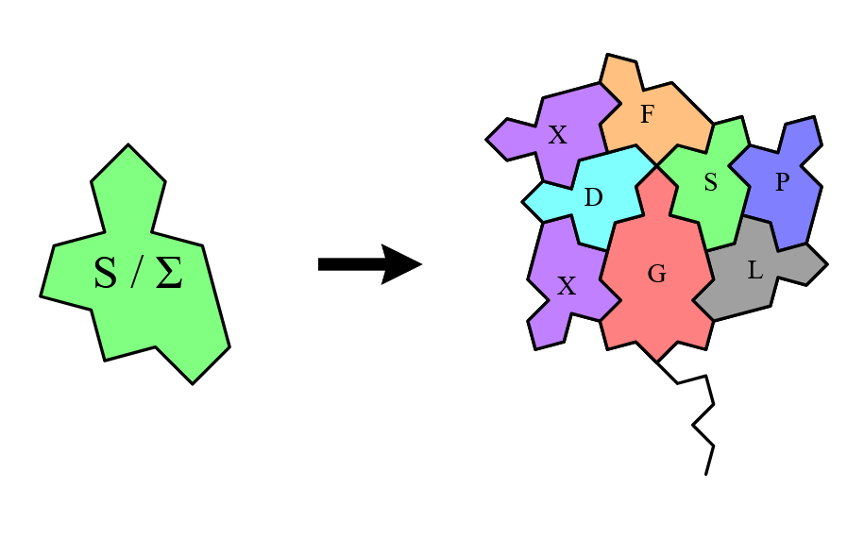
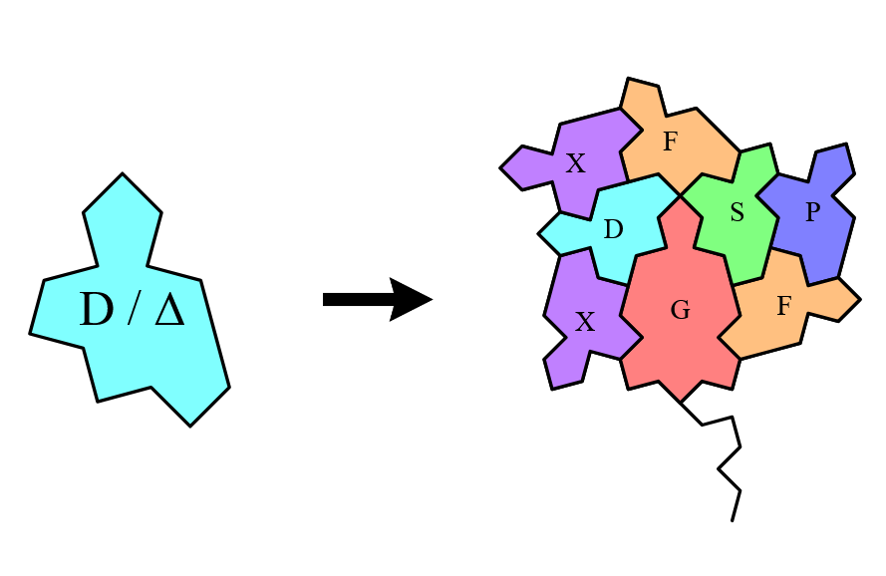
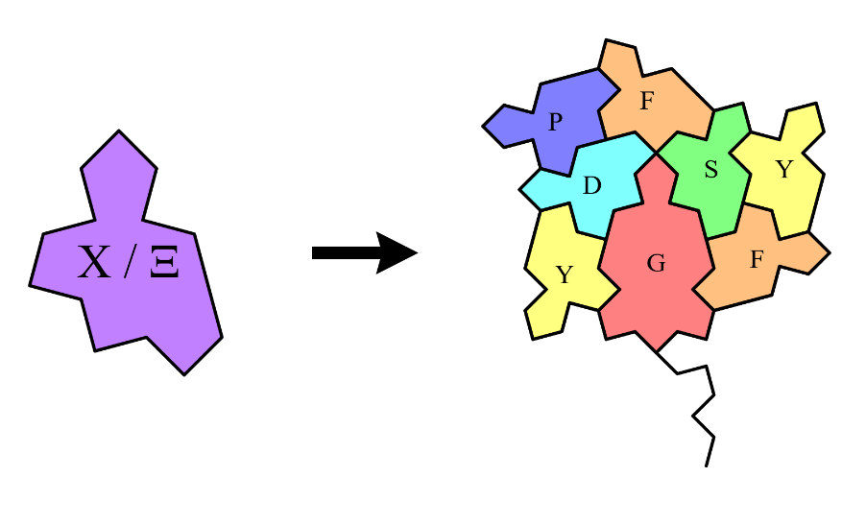
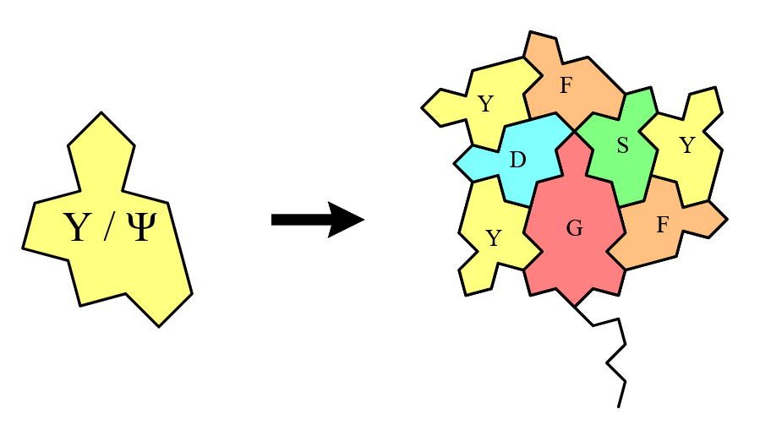
The nine homochiral substitutions by Simon Tathan
https://www.chiark.greenend.org.uk/~sgtatham/quasiblog/aperiodic-refine/

Slide 6
Homochiral python code on github
https://github.com/marimperorclerc/homochiral
python code for drawing clusters with Tile(a,b) in svg graphics
References
Code is based on the drawsvg package:
https://pypi.org/project/drawsvg/
And the python code with alternate chirality for inflation for spectre tiling:
https://github.com/shrx/spectre/blob/master/spectre.py
Adapted here (spectre-colored-tiles.ipynb) with different color choices
See some .svg files in \svg-spectre folder

Slide 7
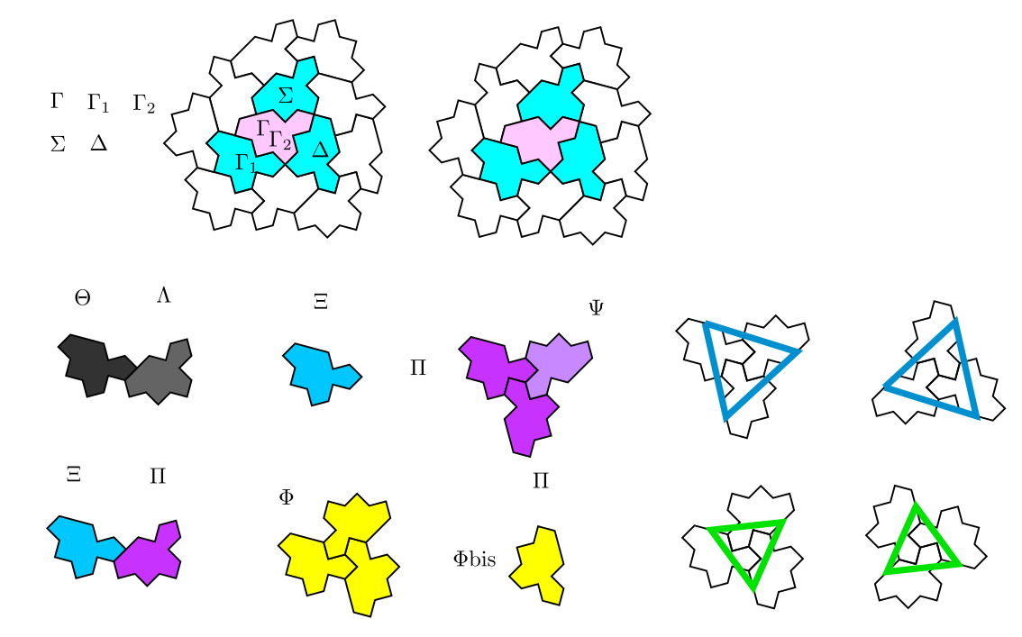
Identification of the greek letters for tiles
Consider a cluster of four tiles instead of 3 for horn in the anatomy ? (by adding the \Delta tile)
Large stars correspond to all \Pi and \Psi tiles
\theta and \lambda always in couple
\phi tiles give all small stars plus isolated ones. Look at the position of the isolated ones (called here \phi_bis) ?
All \chi tiles are linked to a \pi tile and consequently to a large star.

Slide 8
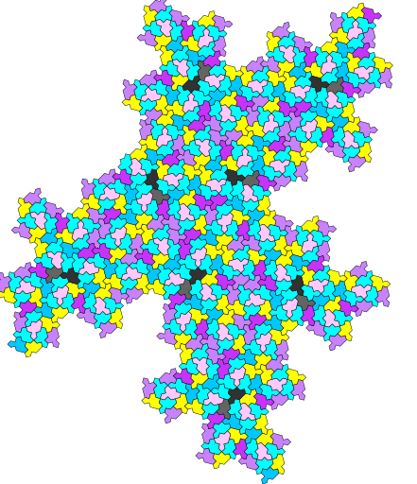
Third inflation with color code from greek letters
\theta and \lambda always in couple -> part of a propeller
Large stars correspond to all \Pi and \Psi tiles
\phi tiles give all small stars plus isolated ones. Look at the position of the isolated ones (called here \phi_bis) ?

Slide 9
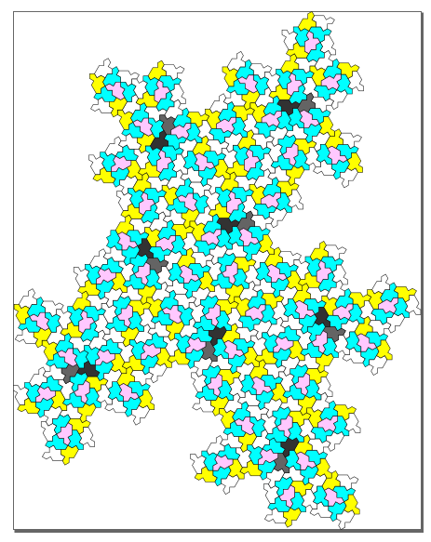
Another version with less colors …
\theta and \lambda always in couple -> part of a propeller
Large stars correspond to all \Pi and \Psi tiles
\phi tiles give all small stars plus isolated ones. Look at the position of the isolated ones (called here \phi_bis) ?

Slide 10
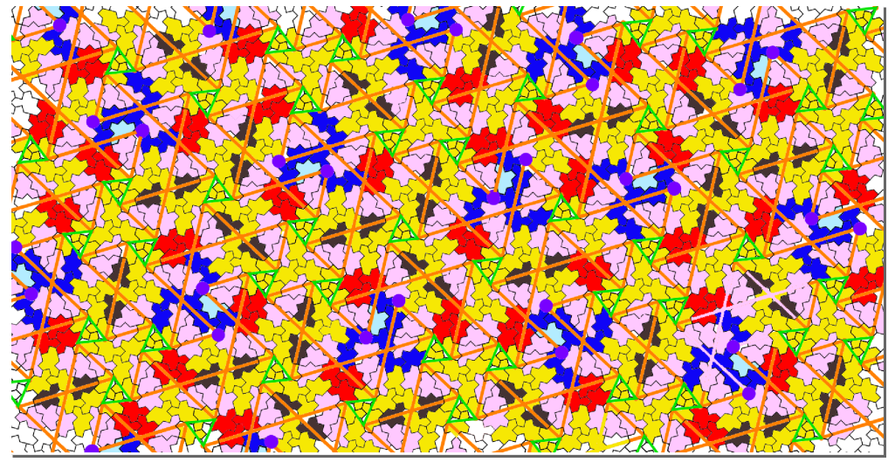
Link with anatomy by Boris Horvat ?

Slide 11
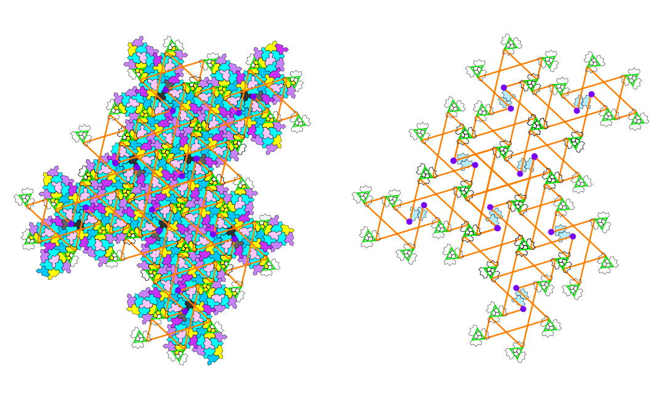
Third inflation: identification of the 2-arms, 3-arms and diabolos

Slide 12
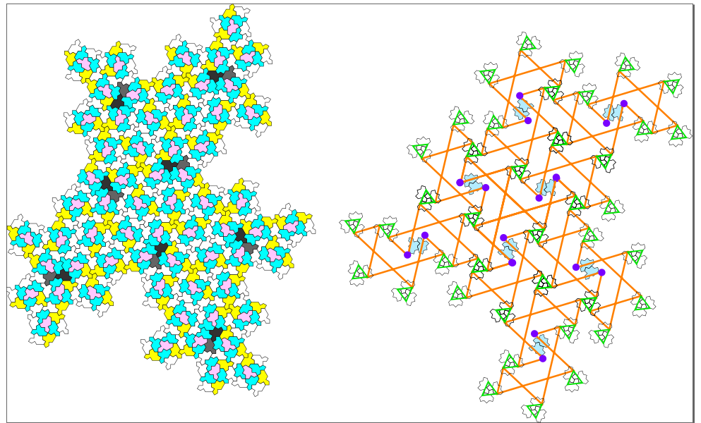
Another version with less colors …
\theta and \lambda couple -> part of a propeller -> highlight a specific configuration of two full clusters !

Slide 13
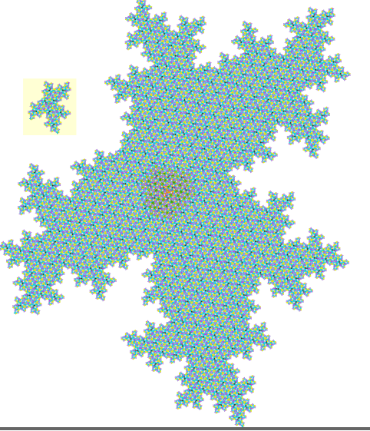
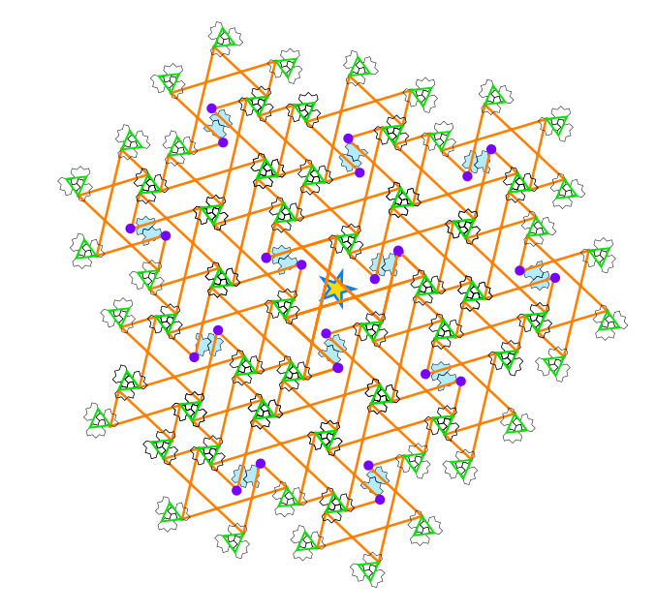
Third to fifth inflation: identification of the 2-arms, 3-arms and diabolos …
Very long to do by hand !!!

Slide 14
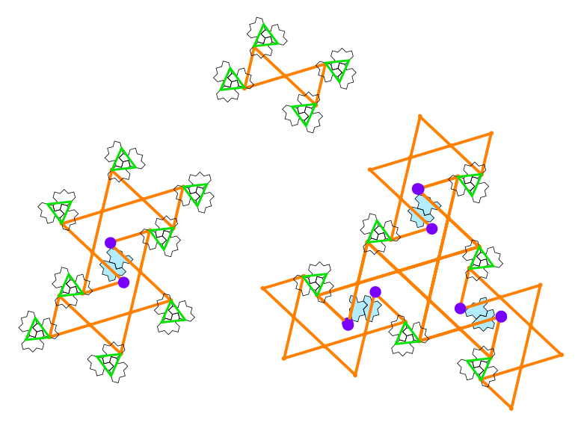
New puzzle

Slide 15
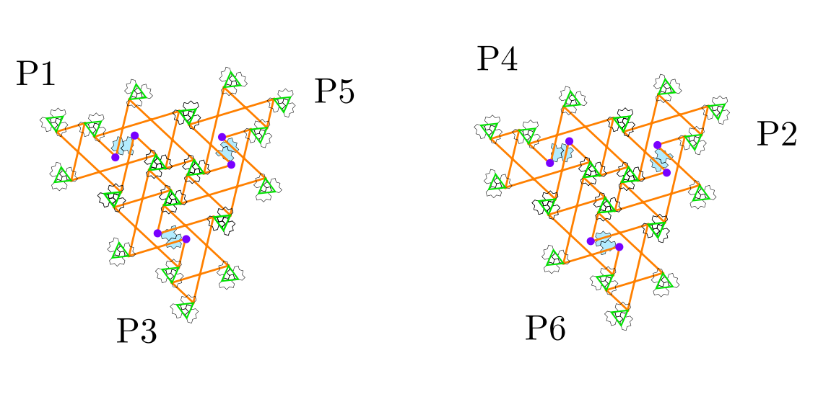
Possible candidate for a seed ?
Three 2-arms can be combined in two ways:

Slide 16
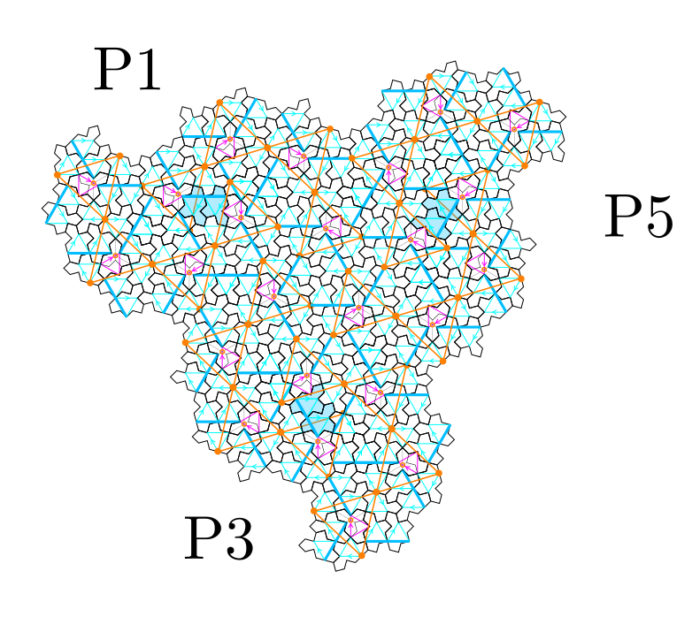
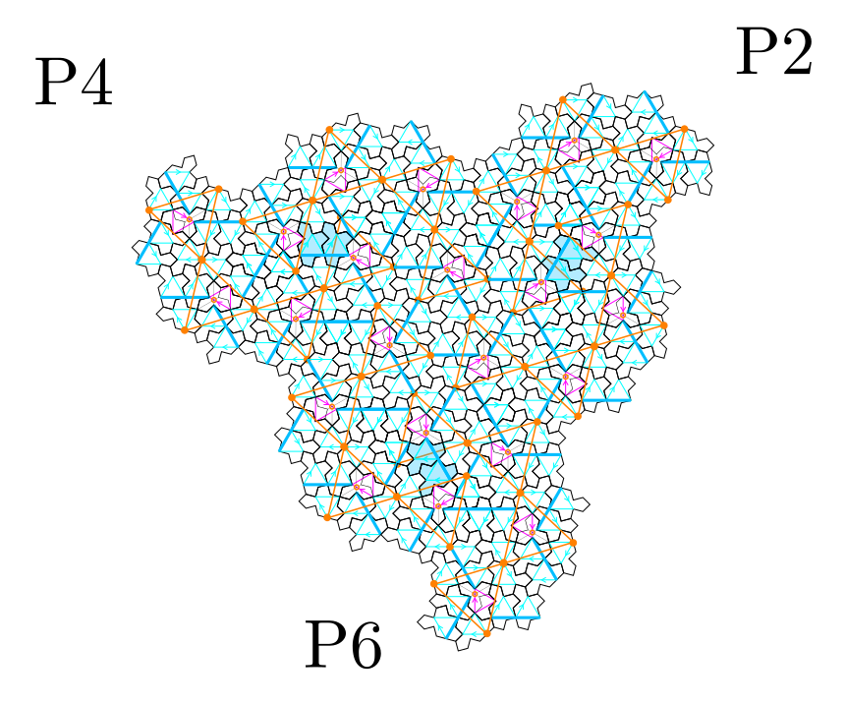
Possible candidate for 3-fold symmetry center
Compare with center of giant star cluster by Boris Horvat ???
True three fold symmetry point at center ???

Slide 17
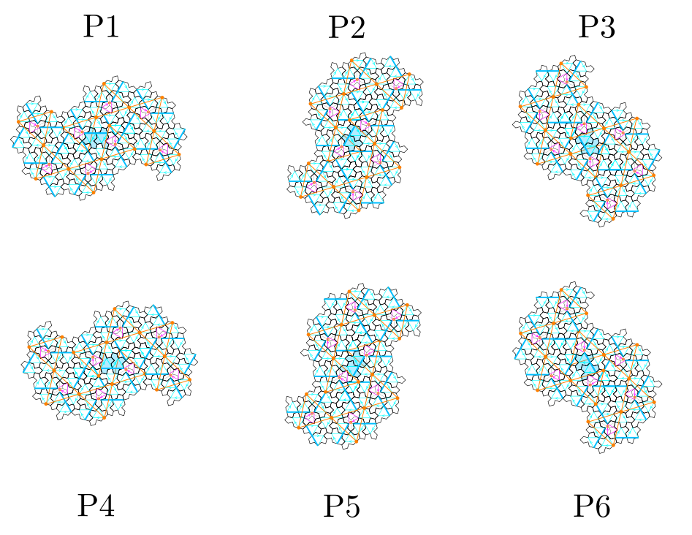
Six orientations of the 2-arms

Slide 18
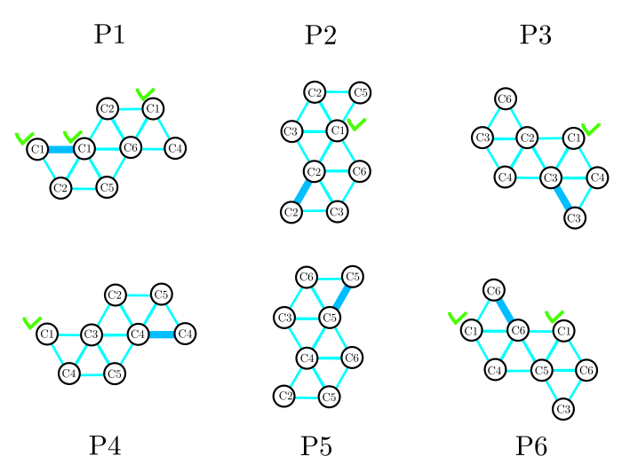
Six orientations of the 2-arms

Slide 19
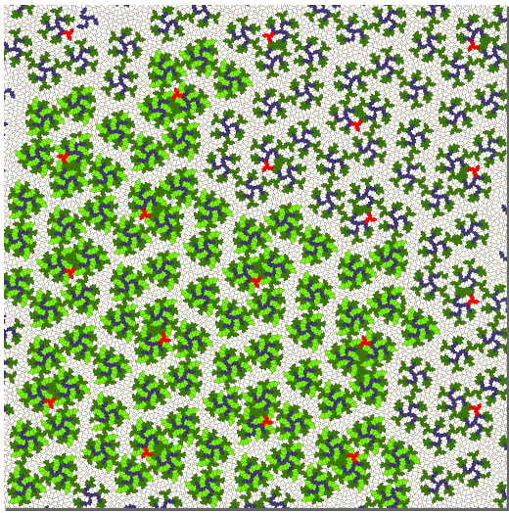
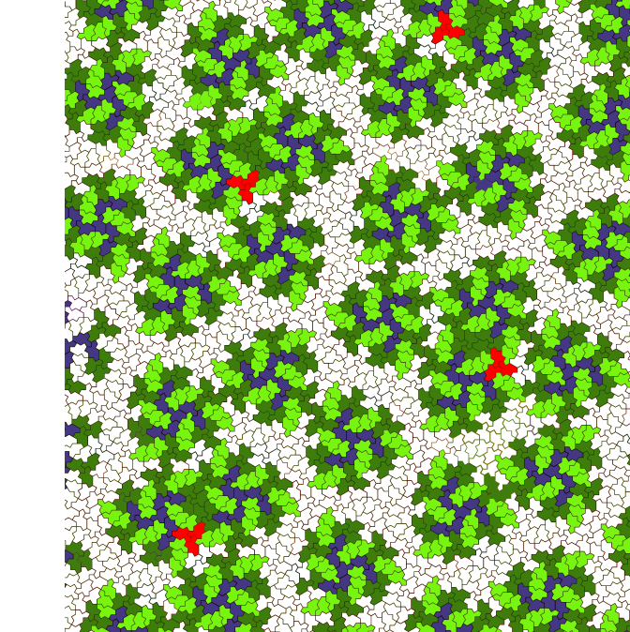
Diabolo/2-arms/3-arms at level 2 by Boris Horvat

Slide 20
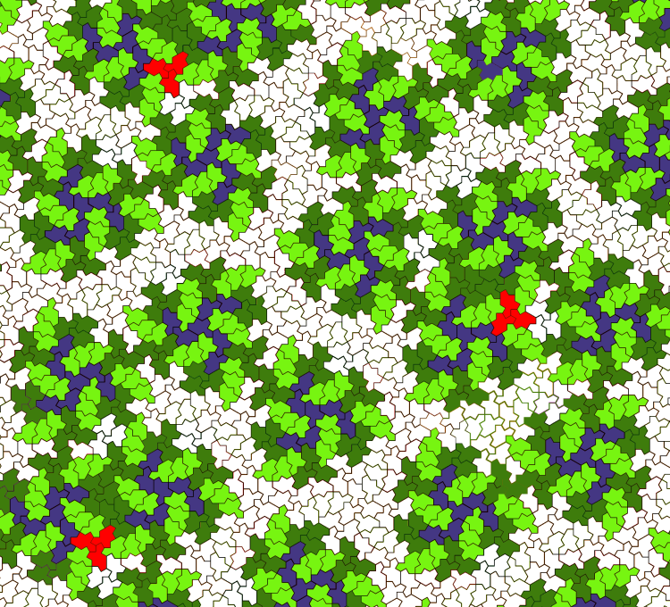
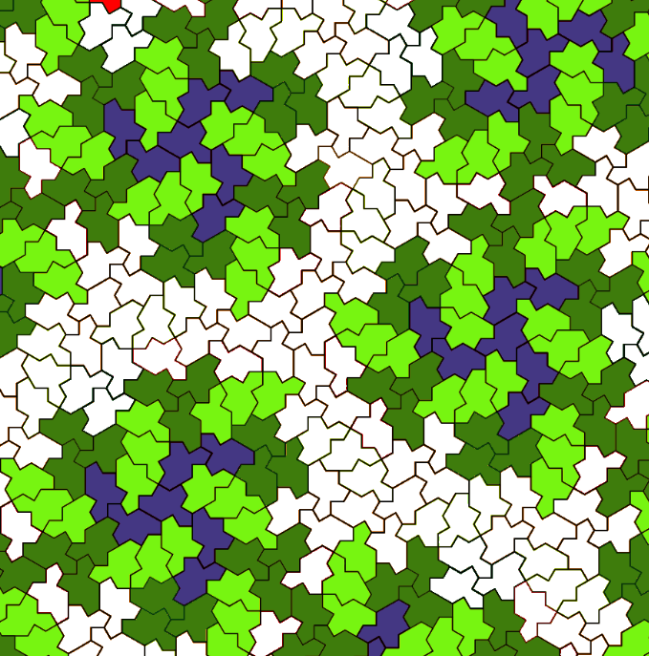
Diabolo/2-arms/3-arms at level 2 by Boris Horvat

Slide 21
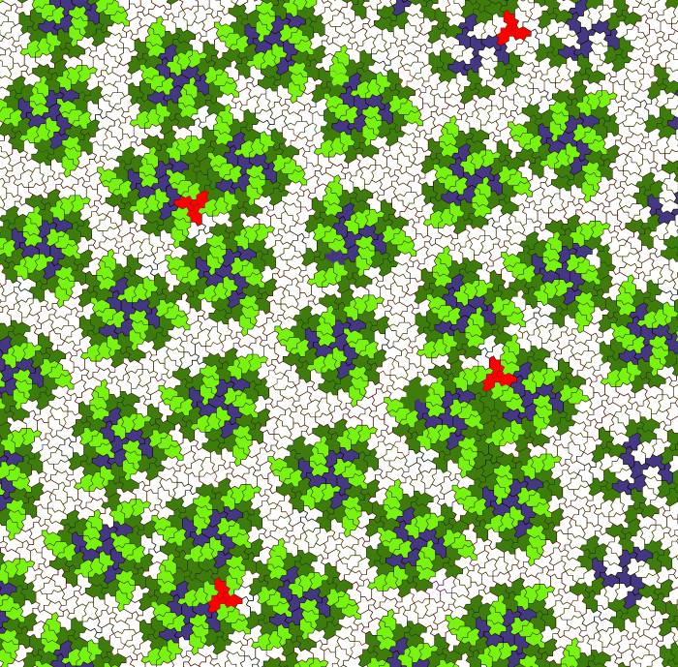
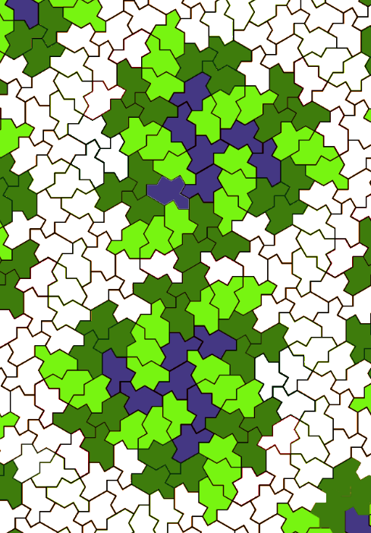
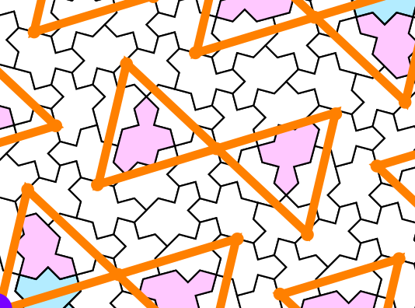
Diabolo/2-arms/3-arms at level 2 by Boris Horvat

Slide 22
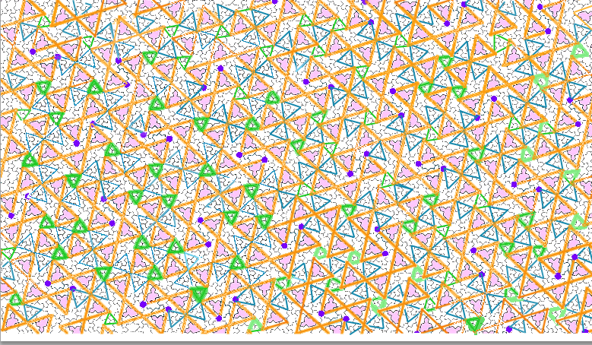
SMALL AND LARGE STARS

Slide 23
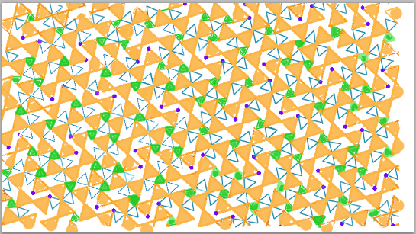

Slide 24

























Espaces entre triangles oranges
Triangles
Parallelogrames
Bateaux
Petits parallelogrames
2 orientations de tuiles

Slide 25
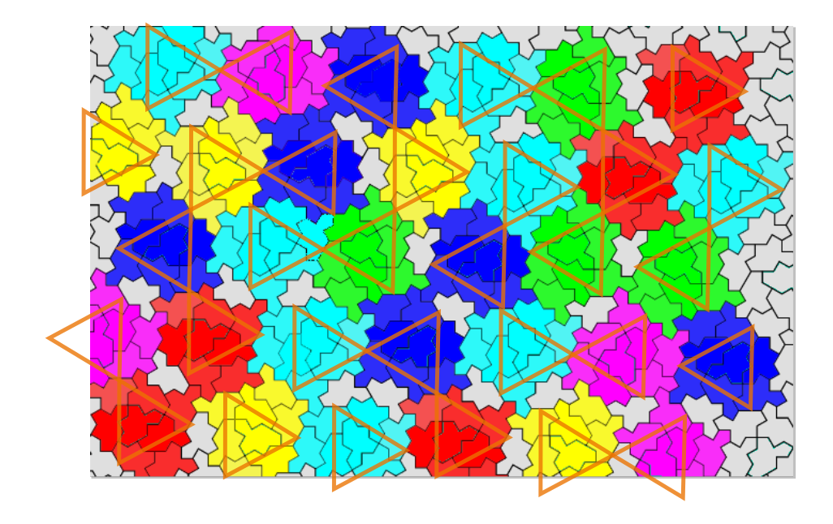

Slide 26
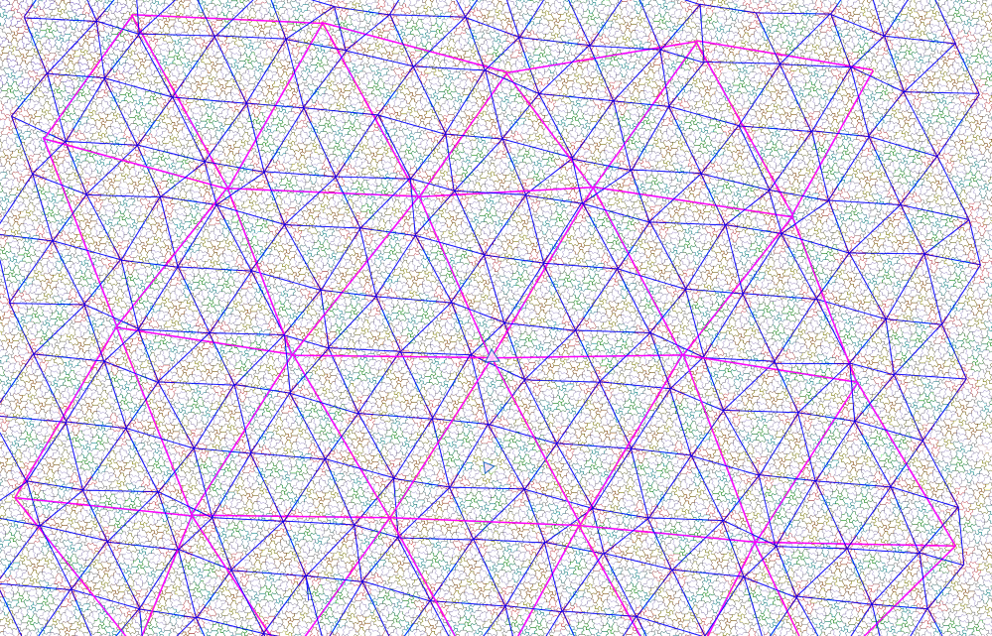
Triangular networks by Boris Horvat
Magenta color: triangular network between the “lone stars”

Slide 27
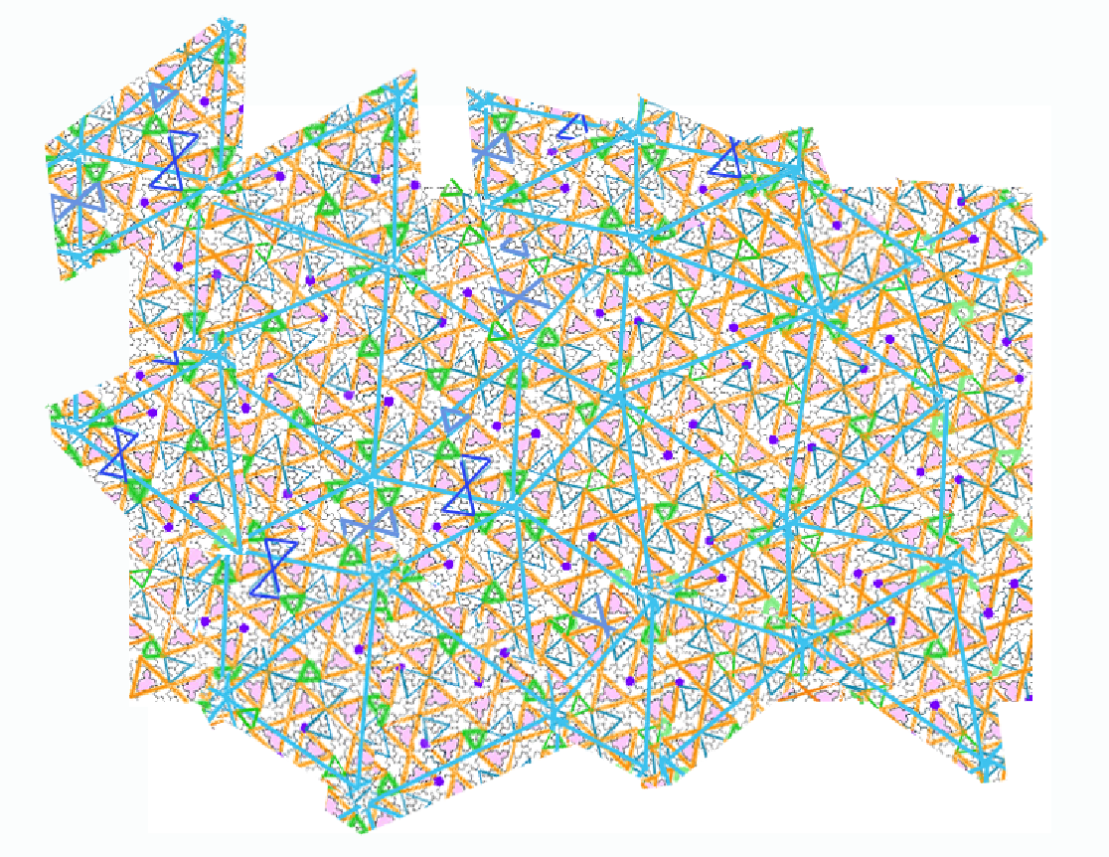
Triangular networks by Jean-François
Same network between the “lone stars”

Slide 28
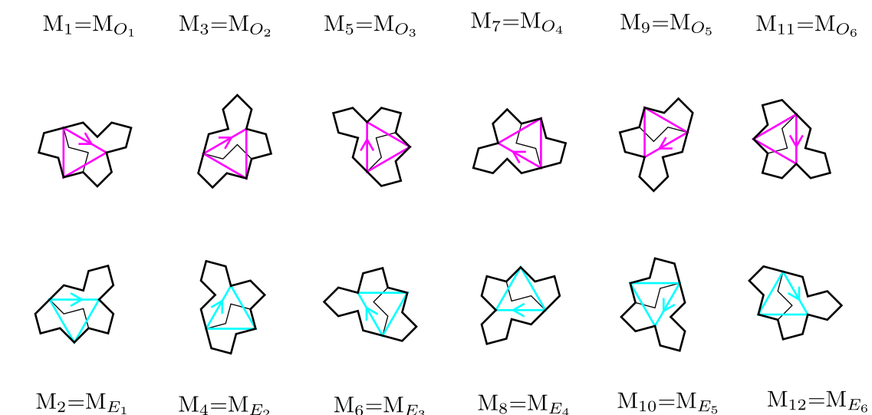
ODD and EVEN orientations for Tile(1,1)

Slide 29
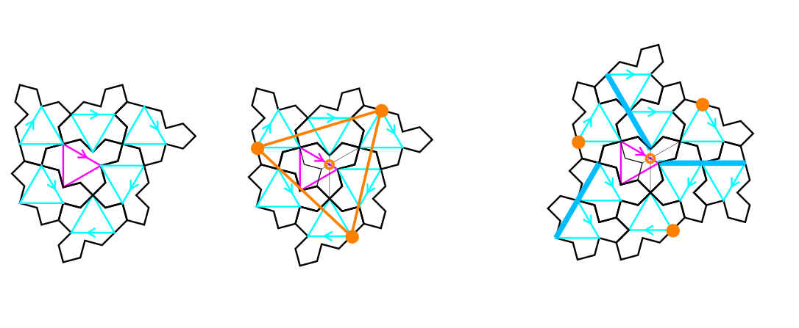
full cluster
Tile(1,1)
C cluster: one ODD tile at the center + 6 EVEN tiles around
Three glue points (orange color): regular triangle centered on the trifle shape of the ODD tile
Full cluster: 3 more EVEN tiles obtained by translations (three dark blue lines)

Slide 30
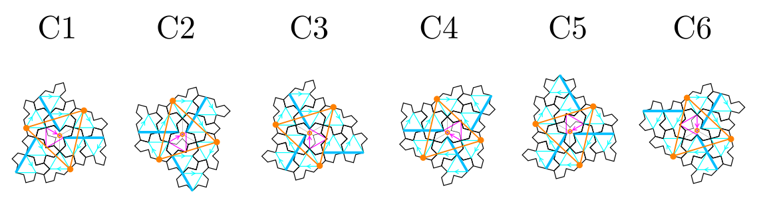
full cluster with its six rotations: n(2pi/6)
Tile(1,1)
13 tiles in a full cluster: one ODD tile at the center + 9 EVEN tiles around
Blue triangles (EVEN) have one horizontal edge when pink (ODD) have a vertical one

Slide 31
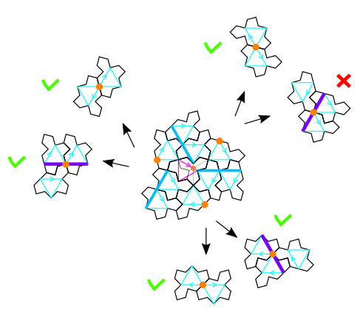
Possible configurations at the glue points ?
Half-turned or translated monotile (violet line)

Slide 32
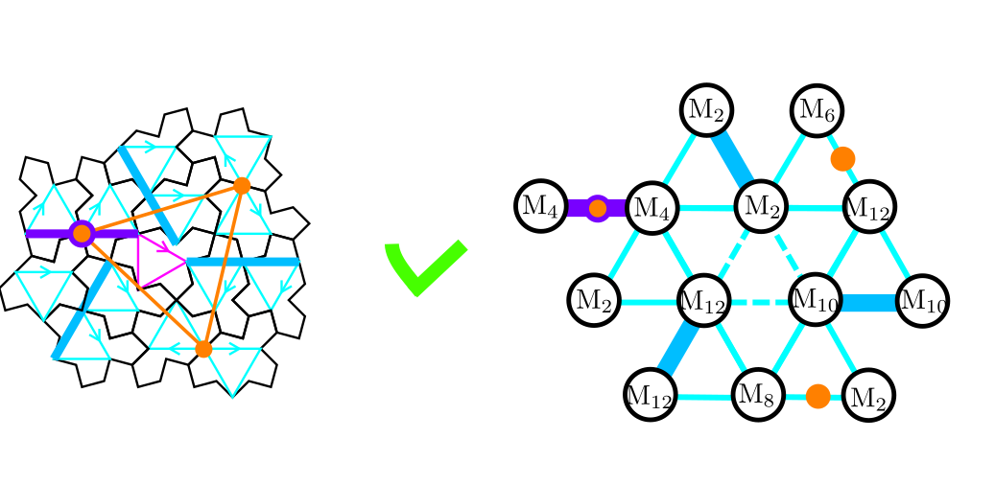
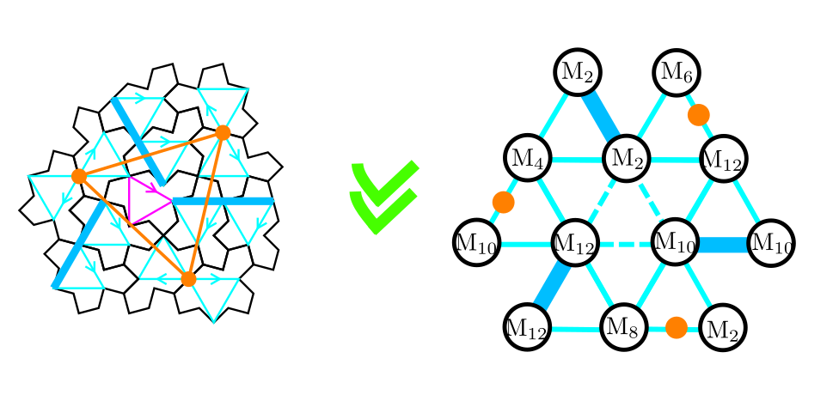
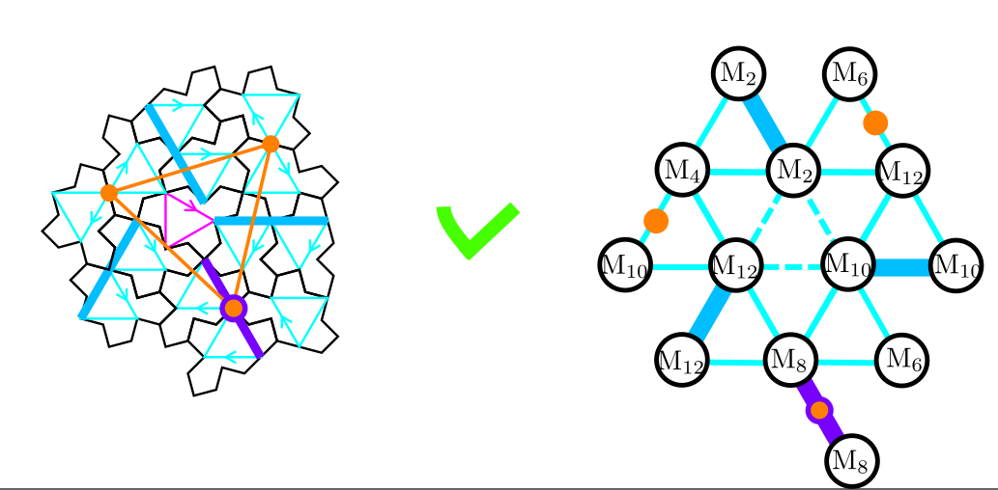
Three possible configurations at the glue points
configuration with three half-turned tiles is the most common
The other two are always coupled together in the tiling:
One violet line in a 2-arms and three violet lines in a 3-arms

Slide 33
Orientation of the EVEN tiles in the most frequent configuration
Tile(1,1)
6 tiles in the C-cluster (corona made of M12, M4, M2, M12, M10, M8)
3 translated (M2, M10, M12) (along blue lines, the edges of blue triangles)
3 half-turned (M4->M10, M12 -> M6, M8 -> M2)

Slide 34
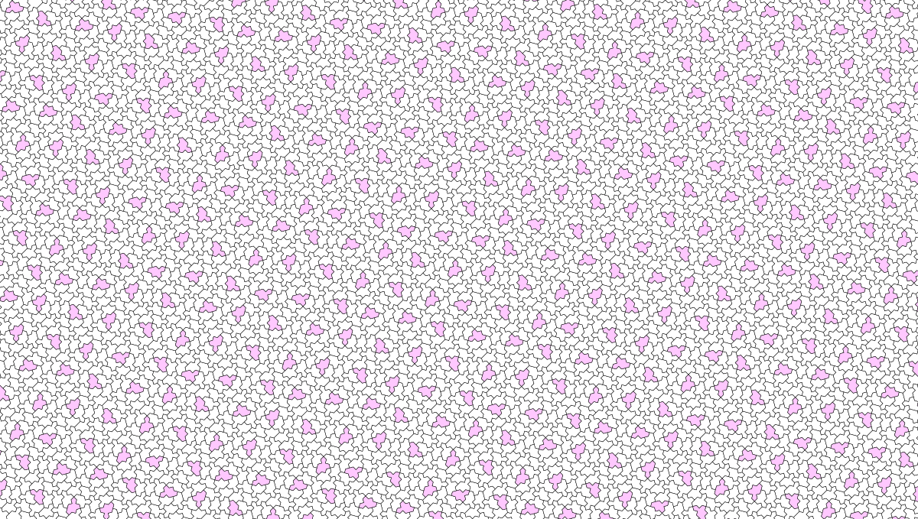
Construction for the whole tiling ???

Slide 35


Three patterns in the whole tiling ☺
3-arms
diabolo
2-arms

Slide 36
Diabolo pattern
Local 2-fold axis

Slide 37


Diabolo pattern

Slide 38

Diabolo pattern
Three orientations of the same diabolo pattern

Slide 39


Two-arms chiral pattern
Two ‘croissants’ of 4 clusters
Two translated monotiles in the middle + superposition of glue points
Easy to code ! ☺

Slide 40


Link with triangular pattern
The two other environnements with a violet lines are always coupled together

Slide 41
Six orientations of the 2-arms

Slide 42
Six orientations of the 2-arms
8 combinations for a given cluster orientation (green crosses)

Slide 43

three orientations for diabolos

Slide 44

Six orientations of the 2-arms

Slide 45






Six orientations of the 2-arms

Slide 46






six orientations of the 3-arms

Slide 47
New puzzle

Slide 48

stars
Small and large stars with two possible orientations

Slide 49

Edge lengths of several triangles:
pink, orange, green and blue
TO DO: calculate the edge length for all these different regular triangles (take 1 for the edge length in the monotile)
And do it after when applying the T(a,b) transformation (all remain regular !)

Slide 50

Small stars connect the orange triangles
Possibility to obtain the relative positions between diabolo, 2-arms and 3-arms

Slide 51

10 environments (C1 orientation)
Left handed version of the figure in Arnaud’s paper.
Chéritat, A., (2024). Observations on the hex clusters of the spectre tilings. https://arxiv.org/abs/2407.05359

Slide 52

10 environments for C1

Slide 53

10 environments for C1

Slide 54

8 different locations in the chiral pattern

Slide 55

10 environments (capital greek letters)
Need to reduce to 8 environments ?

Slide 56


8 types of hexagonal clusters
To do:
Locate the 8 hexagonal clusters in the chiral pattern
Chéritat, A., (2024). Observations on the hex clusters of the spectre tilings. https://arxiv.org/abs/2407.05359

Slide 57
Homochiral python code on github
Under construction !
https://github.com/marimperorclerc/homochiral
python code for drawing clusters with Tile(a,b) in svg graphics.
References
Code is based on the drawsvg package:
https://pypi.org/project/drawsvg/
And the python code with alternate chirality for inflation for spectre tiling:
https://github.com/shrx/spectre/blob/master/spectre.py

Slide 58

Inflation step 1: substitution rule for C1
EVEN tiles in C1
ODD tiles for step 1
same as full clusters
ODD tiles for step 1 are obtained by adding 1 (mod 12) to all EVEN tiles in the C cluster (6 tiles)
Directions of translated and half-turned tiles are exchanged (see the change of position for green points). Then three tiles are translated (M1, M3, M11) and three are half-turned (M5->M11, M1 -> M7, M9 -> M3)
ODD tile index is equivalent to the orientation of a full C cluster ☺

Slide 59


Inflation step 1

Slide 60

Inflation step 1
Directions along the blue lines are the edge directions of the blue triangles !!!

Slide 61

Inflation step 1 for full cluster C1
Assembly of the 12 full clusters works fine !!! (done manually so far for the relative positions of clusters)
Some tiles are superimposed
Some half-turned tiles need to be removed with a simple rule: translation wins over half-turn !
A bigger green triangle is identified, centered on a trifle at the center of the figure ☺

Slide 62

Inflation step 1 for full cluster C1
TO DO: Find a rule for the relative positions between clusters in the assembly
Clusters are translated from each other along the blue lines
Use superposition of green points from two adjacent clusters ???

Slide 63


Defect healing
Starting point for worms ☺
After removing two half-turned tiles

Slide 64


Defect healing
Starting point for worms ☺
After removing two half-turned tiles

Slide 65
TO DO: Step 2
Replace all the 12 full clusters in this pattern with the same rule used previously for C1 (just a rotation of the pattern for C2, C3, C4, C5 and C6)

Slide 66


New reference triangle in Tile(a,b)
Robust for any T(a,b) tile ☺
a=1.6
b=1.2

Slide 67

Link with trifle and bow-tie in Tile(1,1)

Slide 68

Comparison with hexagon/square/rhombus decomposition

Slide 69

Tile(1,1) : spectre tile

Slide 70

translation versus half-turn for any Tile(a,b)
a=1.6
b=1.2

Slide 71

Regular triangle inside Tile(1,1)
Half-bow
Half-bow
Half-trifle
2 other shapes are left:
-> 2 half-bows
-> 1 half-trifle

Slide 72

Cluster and full cluster
a=1.6
b=1.2
C cluster
(corona around a ODD tile)
The three translated tiles are all in the tiling
Three more possible tiles with half-turn around the green points

